Slide 1
Shortest Path Algorithm with Heaps

Slide 2
Introduction
Problem description:
The problem today we are solving is about Dijkstra's algorithm. The task is to implement Dijkstra’s algorithm by Fibonacci heap and other min-priority queue structures. We’re going to fulfill the algorithm by Fibonacci heap and the minimum heap, and analyze the complexity of algorithm then.

Slide 3
Background of the data structures and the algorithms:
Dijkstra's algorithm:
Dijkstra algorithm is a typical single source shortest path algorithm, which is used to calculate the shortest path from one node to all other nodes. The main feature is to expand layer by layer from the starting point to the end point.

Slide 4
void Dijkstra( Table T )
{
Vertex V, W;
for ( ; ; ) {
V = smallest unknown distance vertex;
if ( V == NotAVertex )
break;
T[ V ].Known = true;
for ( each W adjacent to V )
if ( !T[ W ].Known )
if ( T[ V ].Dist + Cvw < T[ W ].Dist ) {
Decrease( T[ W ].Dist to T[ V ].Dist + Cvw );
T[ W ].Path = V;
} /* end-if update W */
} /* end-for( ; ; ) */
}
Notes:
The approximate process of this algorithm can be expressed as:
① Treat the initial points on the graph as one set S, and other points as another set
② According to the initial point, calculate the distance d [i] from other points to the initial point (if adjacent, d [i] is the edge weight; if not adjacent, d [i] is infinite)
③ Select the smallest d [i] (record as d [x]), and add the corresponding point (record as x) of this d [i] edge to the set S. (in fact, the d [x] value of the point added to the set is the shortest distance from the initial point.)
④ According to x, update d [y] value of Y adjacent to X: D [y] = min {d [y], d [x] + edge weight w [x] [y]}, this update operation is called relaxation operation.
⑤ Repeat steps 3 and 4 until the target point is added to the set, and the corresponding d [i] of the target point is the shortest path length.

Slide 5
Fibonacci heap
Fibonacci heap is a set of disordered trees. Each tree is a minimum heap, which satisfies the property of minimum heap. Fibonacci heap has the advantage that it can complete operations such as heap building, insertion, extraction of minimum key words, union in O (1) time. This is a huge improvement in the efficiency of the binomial reactor.

Slide 6
Data Structure / Algorithm Specification
Minimum heap:
1. The minimum heap is a sort of complete binary tree, in which the data value of any non terminal node is not greater than the value of its child nodes.
2. In the project, we use priority_queue in C++ standard library to implement minimum heap: priority_queue<pair<long long, long long>,vector<pair<long long, long long> >,greater<pair<long long, long long> > > minheap;

Slide 7
3. Some basic operations used:
1) push(): add a node into the heap. Time complexity of push is O(logn).
2) pop(): delete the minimum node from heap. Time complexity of pop is O(logn).
3) empty(): judge whether the heap is empty.
4) top(): returns the constant reference of the minimum node. Time complexity of top is O(1).
4. The time complexity of Dijkstra is O( ). By using the heap to optimize the relaxation process, the time complexity can be reduced to o (eloge).

Slide 8
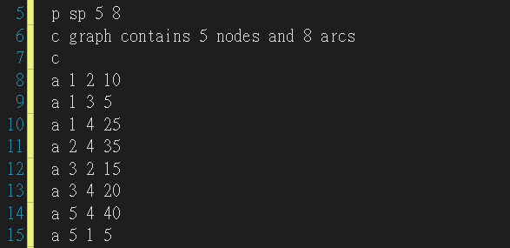
Testing Results
3.1 Accuracy of test program results

Slide 9
Minheap & Fibonacci heap
Minheap & Fibonacci heap
Input | purpose of this case | output | the current status
1 to 1 | Same point | 0 | pass
1 to 2 | Choose the shortest path | 10 | pass
1 to 3 | Only one path | 5 | pass
1 to 4 | Two identical short paths | 25 | pass
1 to 5 | No path | There's no way from 1 to 5 | pass

Slide 10
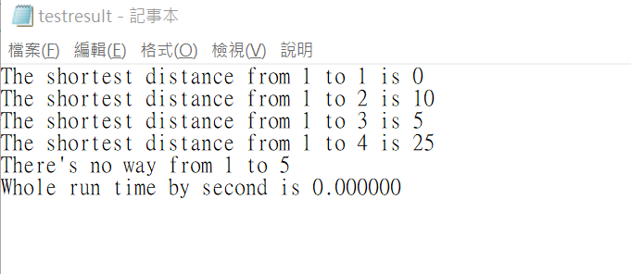

Slide 11
3.2 Time complexity of program
Minheap
N=1000 | t1/s | t2/s | t3/s | tavg/s
 | 81.736000s | 71.100000s | 75.988000s | 76.274667s
N=2500 | t1/s | t2/s | t3/s | tavg/s
 | 118.787000 | 122.391000 | 122.006000 | 121.061333s
N=5000 | t1/s | t2/s | t3/s | tavg/s
 | 226.003000s | 220.640000s | 208.038000s | 218.227000s
N=7500 | t1/s | t2/s | t3/s | tavg/s
 | 329.097000s | 323.169000s | 331.602000s | 327.956000s
N=10000 | t1/s | t2/s | t3/s | tavg/s
 | 443.608000s | 427.868000s | 476.502000s | 449.326000s

Slide 12
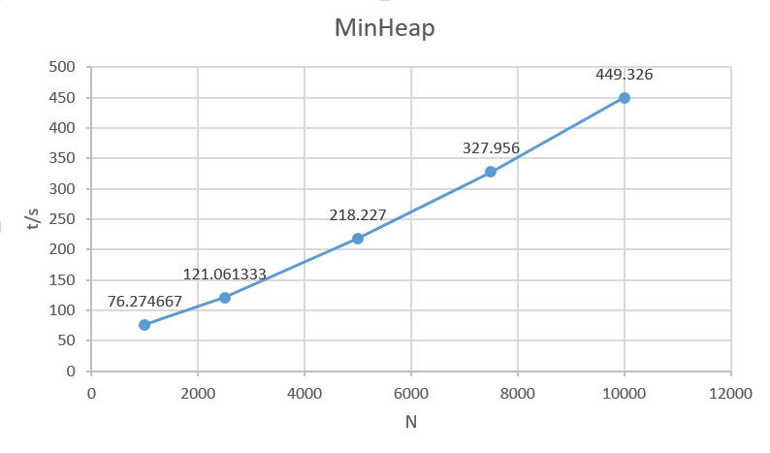

Slide 13
3.2 Time complexity of program
FibonacciHeap
N=100 | t1/s | t2/s | t3/s | tavg/s
 | 3.745000s | 3.490000s | 3.429000s | 3.554667s
N=250 | t1/s | t2/s | t3/s | tavg/s
 | 9.156000s | 11.648000s | 8.704000s | 9.836000s
N=500 | t1/s | t2/s | t3/s | tavg/s
 | 17.774000s | 26.588000s | 30.082000s | 24.814667s
N=750 | t1/s | t2/s | t3/s | tavg/s
 | 44.713000s | 36.709000s | 29.818000s | 37.080000s
N=1000 | t1/s | t2/s | t3/s | tavg/s
 | 51.106000s | 62.035632s | 46.006000s | 53.049211s

Slide 14
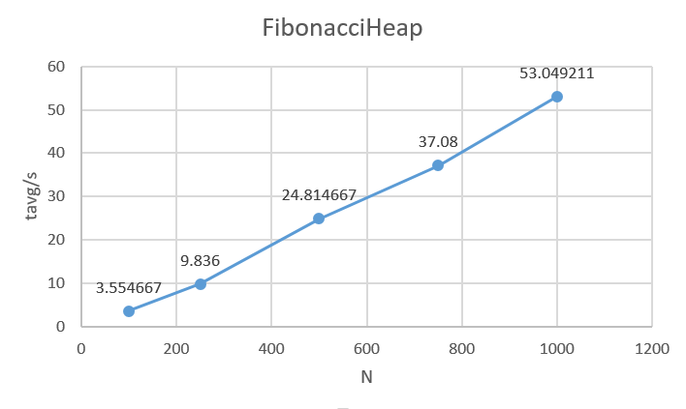

Slide 15

Chapter 4: Analysis and Comments
Analysis :
The Dijkstra algorithm is an algorithm to find the shortest path. But its time complexity is too high. The time complexity of this algorithm is O($e^{2}$). So there is a heap for optimization, here we use the minimum heap and FibonacciHeap.

Slide 16
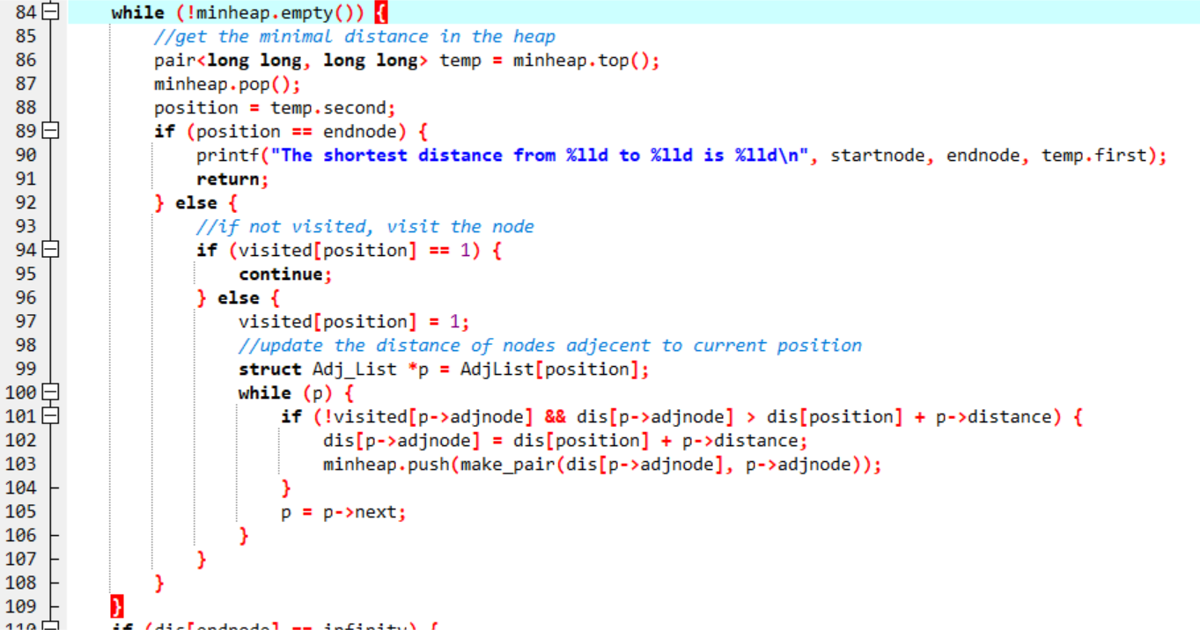
MinHeap-Optimized Dijkstra:
Notes:
MinHeap-Optimized Dijkstra:
The time complexity of MinHeap-Optimized Dijkstra is O(eloge).
Dijkstra's algorithm uses the time complexity of O(e) to find the edge with the least weight. Now we use the priority queue of STL to optimize this process, reducing the time complexity to O (loge). so that the time complexity of MinHeap-Optimized Dijkstra is reduced to O (eloge).
The space complexity of MinHeap-Optimized Dijkstra is o(e). The space complexity is decided by the total number of edges.

Slide 17
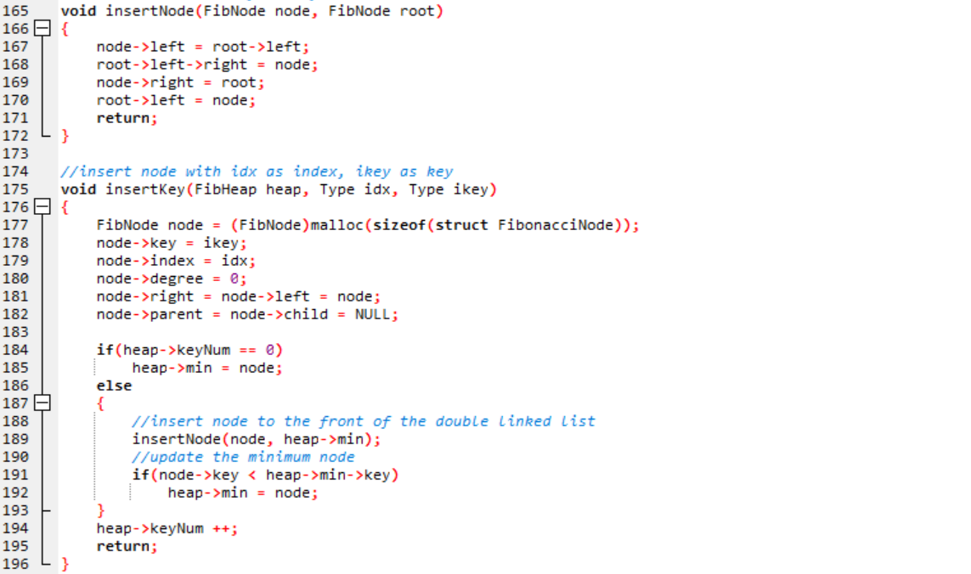
FibonacciHeap -Optimized Dijkstra:
Notes:
It is very obvious the time complexity of insertKey() and insertNode() are O(1).

Slide 18
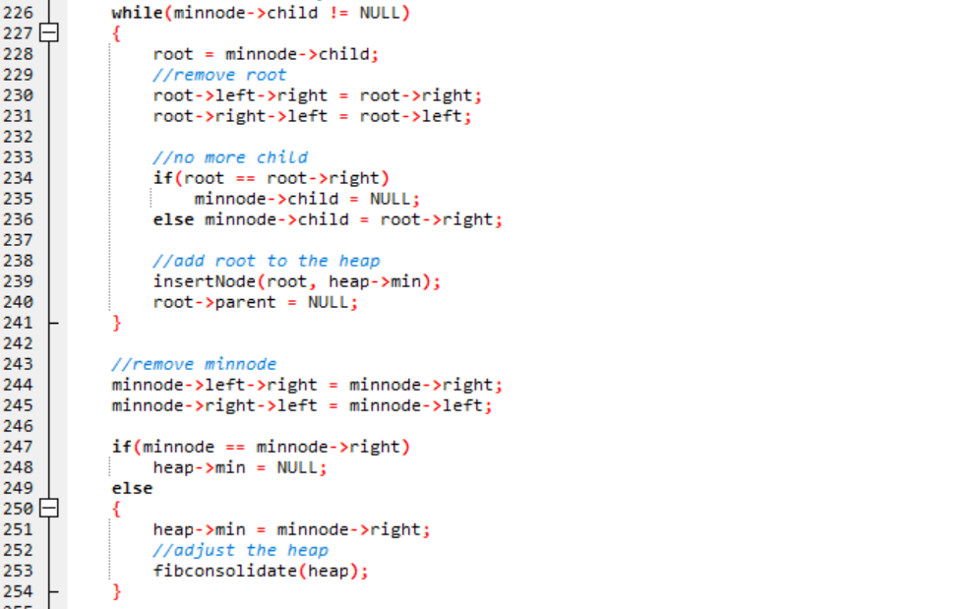
FibNode extractmin(FibHeap heap)
Notes:
The operation of extracting the minimum node is complicated operation in the Fibonacci heap. First we need to find the minimum root node and delete it, and then all its children are added the root to the heap.

Slide 19
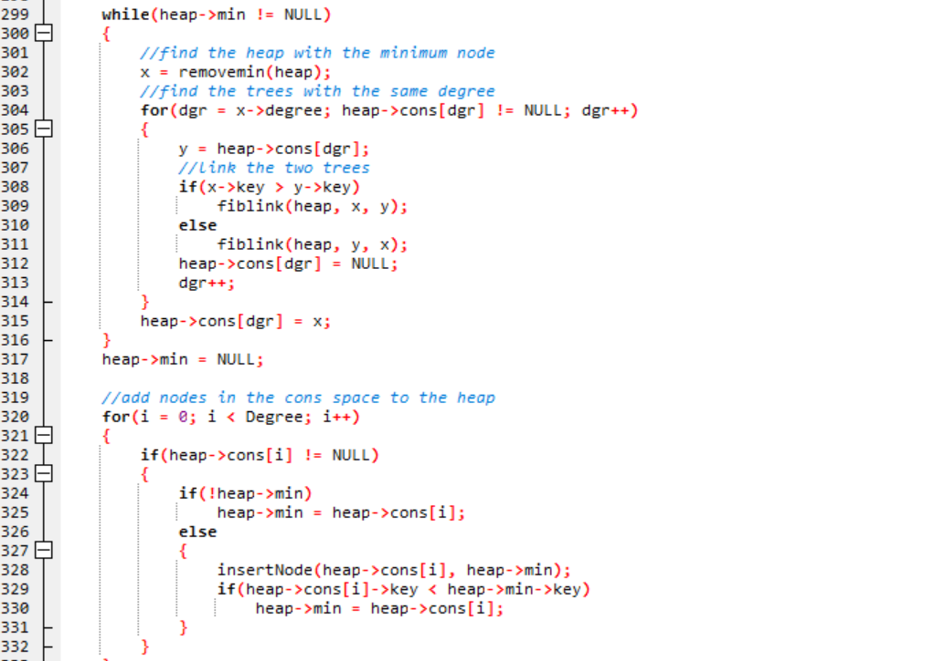
void fib_consolidate(FibHeap heap)
Notes:
We need to find and maintain the minimum root node of the heap, so we merge the other root nodes with the same degree to the two trees and maintain the state of the array.

Slide 20
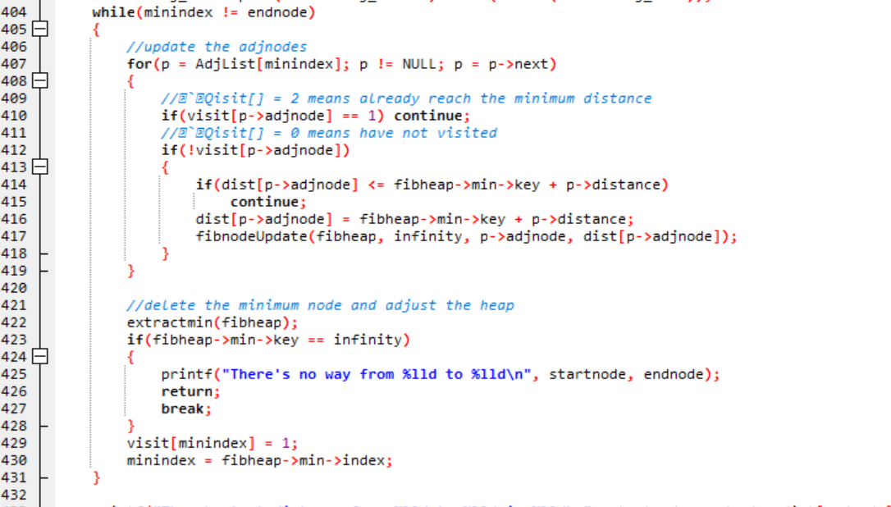
Notes:
We only need O (e) time to put all the edges in the fibheap
Then loop v times to find the edge with the smallest value, so the time required is O (vlogv).
The time complexity of FibonacciHeap -Optimized Dijkstra is o(e +vlogv).
The space complexity of FibonacciHeap -Optimized Dijkstra is o(e). The space complexity is decided by the total number of edges.

Slide 21
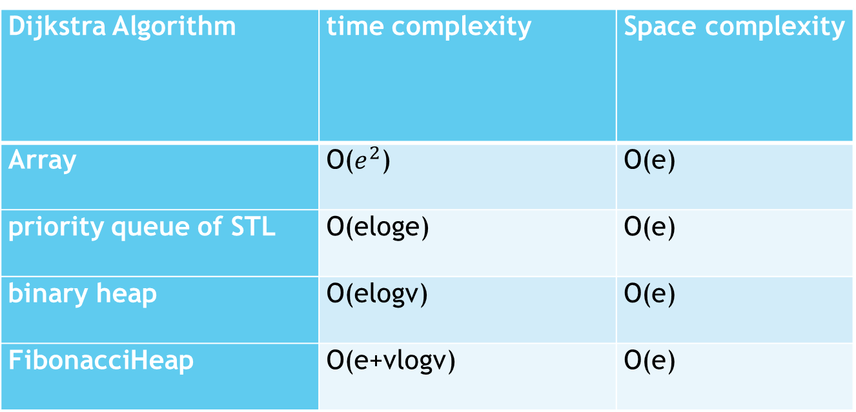
Comments :
Dijkstra Algorithm | time complexity | Space complexity
Array | O($e^{2}$) | O(e)
priority queue of STL | O(eloge) | O(e)
binary heap | O(elogv) | O(e)
FibonacciHeap | O(e+vlogv) | O(e)
Notes:
This time we chose the implementation of the priority queue of STL and FibonacciHeap. According to the table, the time complexity of the binary heap is less than the priority queue of STL. From the table, the time complexity of the binary heap is less than the priority queue of STL. The implementation effect of the binary heap is better but not obvious and the program is more complicated than the program using the priority queue of STL.
The use of Fibonacci heaps is more efficient than using the MinHeap after processing each selection, which requires updating the distance between all vertices and the source point. This also means that the time complexity of using the Fibonacci heap will be lower than the time complexity of using the MinHeap.
The time complexity of FibonacciHeap -Optimized Dijkstra is o(ke +vlogv). k is a constant. However, because k is relatively large, the data must have a large scale to show the advantage of complexity.
In choosing which implementation version to use, we need to consider the actual situation, such as the size of the data, the density of the graph, and the time that can be used to write the program.

Slide 22
Thank you

